Slide 1
Problem solving with perimeter and area
Perimeter and area

Slide 2
how to use Oak lessons

Slide 3
I can use my knowledge of perimeter and area to solve problems.

Slide 4
The area is the size of the surface and states the number of unit squares needed to completely cover that surface.
The perimeter is the distance around a 2D shape.

Slide 5

Problem solving with perimeter and area
Using one to find the other
Perimeter and area in context
Units of measurement

Slide 6
Using one to find the other
Knowledge of the perimeter of a shape could be useful when calculating the area.
Similarly, knowledge of the area of a shape could be useful when calculating the perimeter.

Slide 7
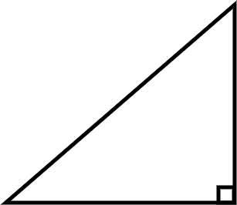
Using one to find the other
The perimeter of this shape is 115 cm. What is the area?
115 = Perimeter
115 = 63 + 28 + base
115 = 91 + base
24 = base
Area = ½ × base × height
Area = ½ × 24 × 28
Area = 336 cm²
63 cm
28 cm

Slide 8
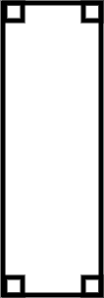
Using one to find the other
The area of this shape is 225 mm². What is the perimeter?
Area = length × width
225 = 25 × width
9 = width
Perimeter = 25 + 25 + 9 + 9
Perimeter = 68 mm
25 mm

Slide 9
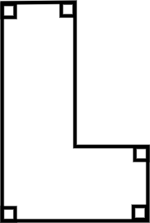

Using one to find the other
I need to know the perimeter to work out the area for this shape.
6 m
10 m
2.5 m
You can already work out the area.
5 m

Slide 10
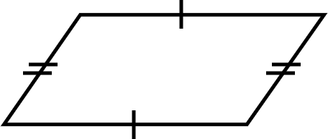
Using one to find the other
1) The perimeter of this shape is 31 units. Calculate the area.
4 units
6 units

Slide 11
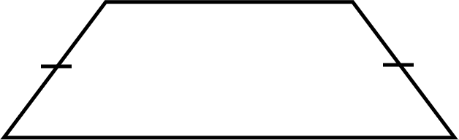
Using one to find the other
2) The area of this shape is 63 units². Calculate the perimeter.
6 units
5 units
13 units

Slide 12
Using one to find the other
1) The perimeter of this shape is 31 units. Calculate the area.
Perimeter = 6 + 6 + 2 × base
31 = 12 + 2 × base
19 = 2 × base
9.5 = base
Area = base × perpendicular height
Area = 9.5 × 4
Area = 38 units²
4 units
6 units

Slide 13
Using one to find the other
2) The area of this shape is 63 units². Calculate the perimeter.
Area = ½ × (a + b) × h
63 = ½ × (a + 13) × 6
63 = 3 × (a + 13)
21 = a + 13
8 = a
Perimeter = 8 + 13 + 2 × 5
Perimeter = 31 units
6 units
5 units
13 units

Slide 14
Problem solving with perimeter and area
Using one to find the other
Perimeter and area in context
Units of measurement

Slide 15
Perimeter and area in context
You may need to calculate either the area or perimeter to solve a problem.
The context (situation) of the problem can help determine what you need to calculate.

Slide 16
Perimeter and area in context
Sort each situation based on whether you would need to calculate the area or the perimeter.
Perimeter
The size of a field.
Tiling the bathroom.
Plot of land for a house.
Fencing a garden.
Area
Walking around a football pitch.
Painting a wall.

Slide 17
Perimeter and area in context
Sort each situation based on whether you would need to calculate the area or the perimeter.
Perimeter
Fencing a garden.
Walking around a football pitch.
The plot of land could be either, depending on whether you are marking the boundary or considering the size of the land.
Plot of land for a house.
Area
Tiling the bathroom.
The size of a field.
Painting a wall.

Slide 18
Perimeter and area in context
1) Alex’s garden is an unusual shape. He wants to put a fence around it. What is the total length of fencing he needs to buy?
4 m
10 m
7 m

Slide 19
Perimeter and area in context
2) a) Jun is a painter. They want to create a mural. How much space will the mural take up?
b) The rectangular wall Jun plans to paint on measures 21 cm by 38 cm. Will the mural fit on the wall? Justify your answer.
26 cm
21 cm
38 cm
50 cm

Slide 20
Perimeter and area in context
1) Alex’s garden is an unusual shape. He wants to put a fence around it. What is the total length of fencing he needs to buy?
Perimeter is needed here - Alex talks about length and the context is fencing which goes around the garden.
Total length of fencing = 2 × 10 + 2 × 7
Total length of fencing = 34 m
4 m
10 m
7 m

Slide 21
Perimeter and area in context
2) a) Jun is a painter. They want to create a mural. How much space will the mural take up?
26 cm
Area is needed here - we want to know how much space is being covered.
Area = ½ × (26 + 50) × 21
Area = 798 cm²
21 cm
38 cm
50 cm

Slide 22
Perimeter and area in context
b) The rectangular wall Jun plans to paint on measures 21 cm by 38 cm. Will the mural fit on the wall? Justify your answer.
If we calculate the area of the wall, we see it is 21 × 38 = 798 cm². This is the same area as the mural, so we might think it will fit.
However, the wall measures 21 cm by 38 cm. The longest measurement of the mural is 50 cm. If we draw this out on paper, we can see that the mural is simply too big.

Slide 23
Problem solving with perimeter and area
Using one to find the other
Perimeter and area in context
Units of measurement

Slide 24
Units of measurement
In this example, area is found by calculating the number of unit squares needed to completely cover the solid blue colour.
But why do we use squares and not a different shape?

Slide 25
Units of measurement
In this example, area is found by calculating the number of unit squares needed to completely cover the solid blue colour.
One of the properties of squares is that the lengths of the sides are all equal. This means the units used to measure them should be the same.

Slide 26

Units of measurement
These shapes are not drawn to scale.
Are either of these shapes squares?
How do you know?
1 m
20 mm
10 cm
2 cm

Slide 27
Units of measurement
These shapes are not drawn to scale.
Are either of these shapes squares?
This shape is not a square because 1 m is 100 cm, not 10 cm.
Therefore the lengths are not the same.
1 m
10 cm

Slide 28
Units of measurement
These shapes are not drawn to scale.
Are either of these shapes squares?
This shape is a square because 20 mm is equivalent to 2 cm.
Therefore the lengths are the same.
20 mm
2 cm

Slide 29

Units of measurement
5 cm
This shape is a square.
50 mm
50 mm is the same as 5 cm.

Slide 30
Units of measurement
Side lengths should be converted so that they all use the same units before any calculations are carried out.
5 cm
5 cm
50 mm
50 mm
5 cm
50 mm
Area = 5 × 5
Area = 25 cm²
Area = 50 × 50
Area = 2500 mm²

Slide 31
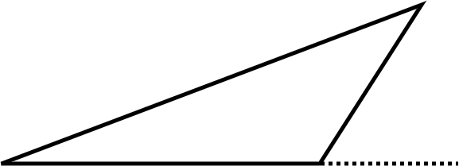
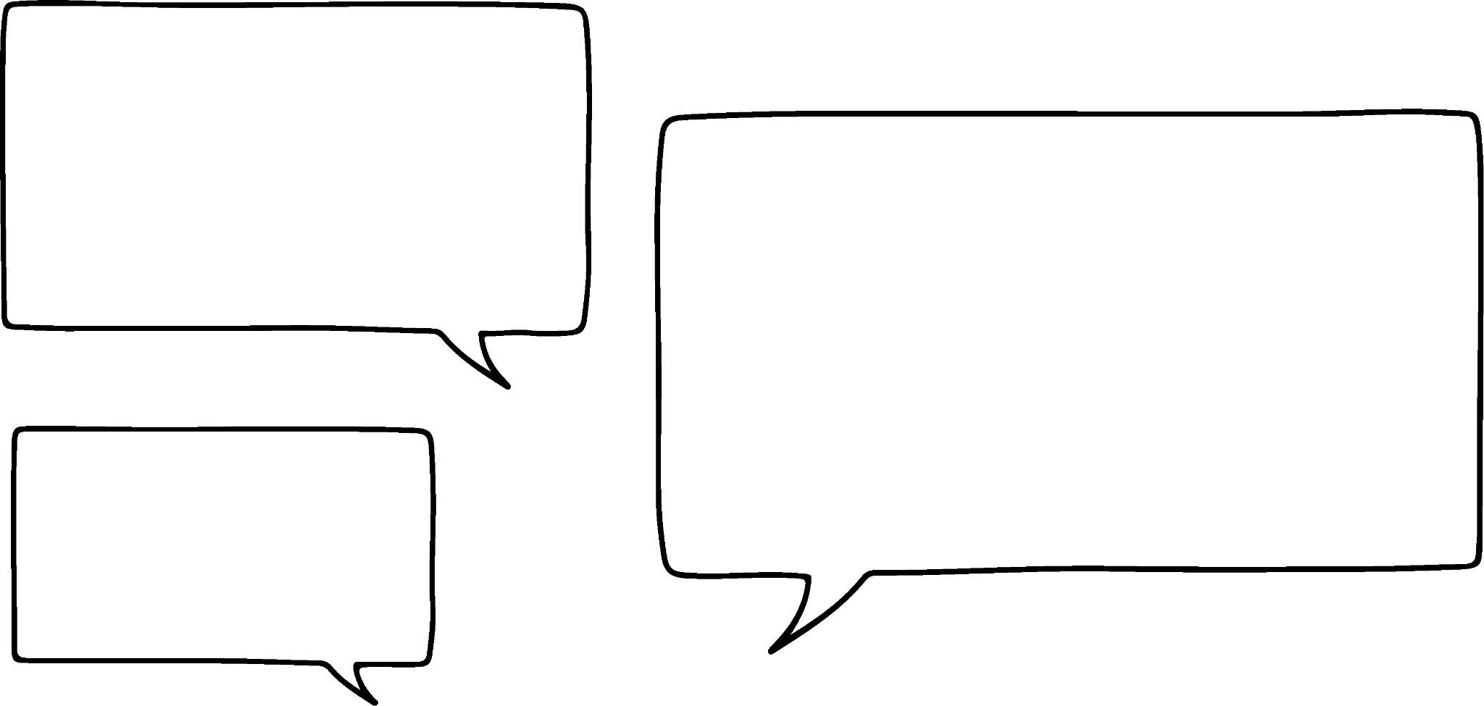
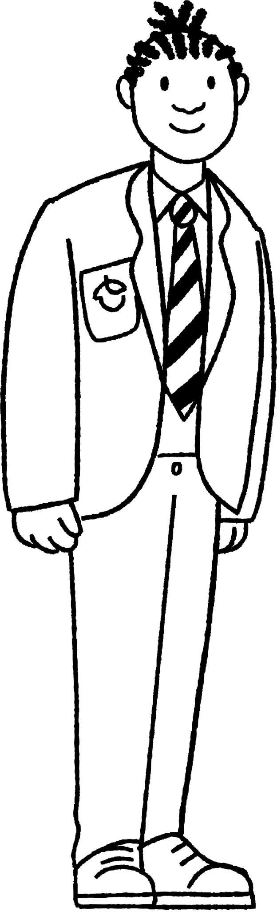
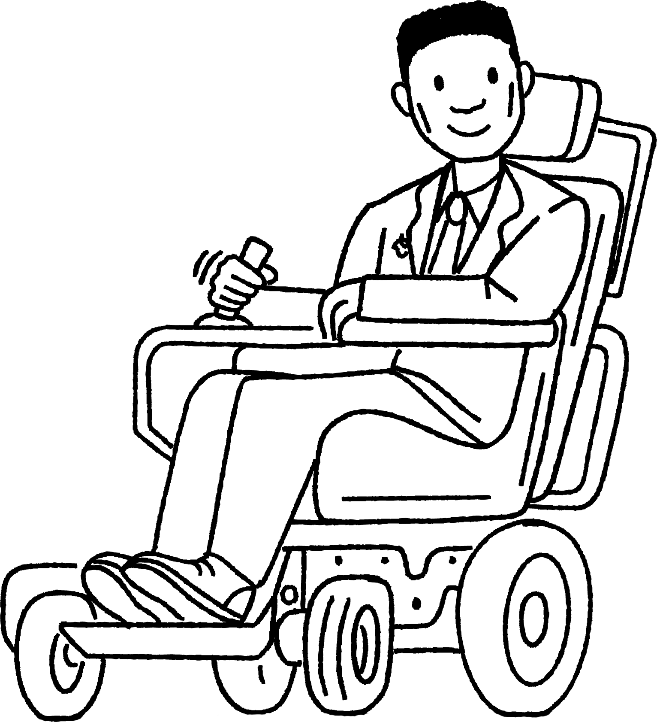
Units of measurement
72 cm
The area is 226.6 cm².
6.3 m
The area is 4.536 m².
Work out the error each has made.
Jacob
Lucas

Slide 32
Units of measurement
72 cm
The area is 226.6 cm².
6.3 m
Jacob has worked out 6.3 × 72 × ½ = 226.6
Jacob has not converted the 6.3 m into cm.
Jacob

Slide 33
Units of measurement
72 cm
6.3 m
The area is 4.536 m².
Lucas has worked out 6.3 × 0.72 = 4.536
Lucas has not multiplied by ½ so he has found the area of a rectangle and not a triangle.
Lucas

Slide 34
Units of measurement
1) Andeep’s sister wants to tile a wall in her bathroom. The wall is rectangular and measures 3 m by 4.5 m.
Each tile is a square which measures 50 cm by 50 cm.
How many tiles will she need to use to cover the wall?

Slide 35
Units of measurement
1) Andeep’s sister wants to tile a wall in her bathroom. The wall is rectangular and measures 3 m by 4.5 m.
Each tile is a square which measures 50 cm by 50 cm.
How many tiles will she need to use to cover the wall?
E.g.
One tile has an area of 50 × 50 = 2500 cm².
The wall has an area of 300 × 450 = 135000 cm².
Therefore 135000 ÷ 2500 = 54 tiles will be needed.
Check your answer.

Slide 36
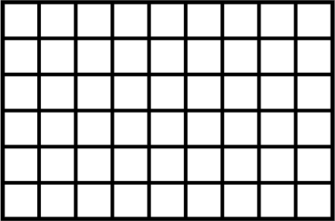
Units of measurement
1) Andeep’s sister wants to tile a wall in her bathroom. The wall is rectangular and measures 3 m by 4.5 m.
Each tile is a square which measures 50 cm by 50 cm.
How many tiles will she need to use to cover the wall?
Checking the answer:
4.5 m
Each tile is 0.5 m by 0.5 m.
9 tiles fit along the 4.5 m side.
6 tiles fit along the 6 m side.
9 × 6 = 54 tiles
3 m

Slide 37
Problem solving with perimeter and area
Perimeter can be useful when calculating area.
Area can be useful when calculating perimeter.
The context of a problem can help you determine what you need to calculate.
Side lengths should be converted so that they all use the same measurement before any calculations are carried out.

Slide 38

© Oak National Academy 2024.
Produced in partnership with Mathematics in Education and Industry.
Licensed on the Open Government Licence v3.0, except where otherwise stated. See Oak terms and conditions.

